Slide 1

Indications for Tourniquet Use
Severe Hemorrhage
For uncontrolled bleeding from an extremity.
Traumatic Amputation
Essential for managing severe limb loss.
Direct Pressure Failure
When direct pressure isn't enough to stop bleeding.
Multiple Casualties
In situations with many injured individuals.
Rapid Evacuation
When quick transport is necessary.

Slide 2

Tourniquet Application
01
Placement
Place 5–7 cm above the wound, avoiding joints.
02
Tighten
Tighten until bleeding stops completely.
03
Note Time
Record the exact time of application.
04
No Field Removal
Do not remove the tourniquet in the field.

Slide 3

Tourniquet Myths vs. Reality
Old Belief: Causes Limb Loss
Historically, tourniquets were feared for causing limb damage.
Evidence: Saves Lives
Modern evidence shows tourniquets are crucial for survival.
Rare Complications
Complications are uncommon when applied correctly.
Delay is Dangerous
Delaying bleeding control poses a greater risk than proper tourniquet use.

Slide 4

Introduction to Traumatic Brain Injury (TBI)
Traumatic Brain Injury (TBI) is a disruption of brain function caused by external trauma, leading to significant disability and death.
Road Traffic Accidents
A leading cause of TBI.
Falls
Common in all age groups.
Assaults
Physical violence can result in TBI.

Slide 5
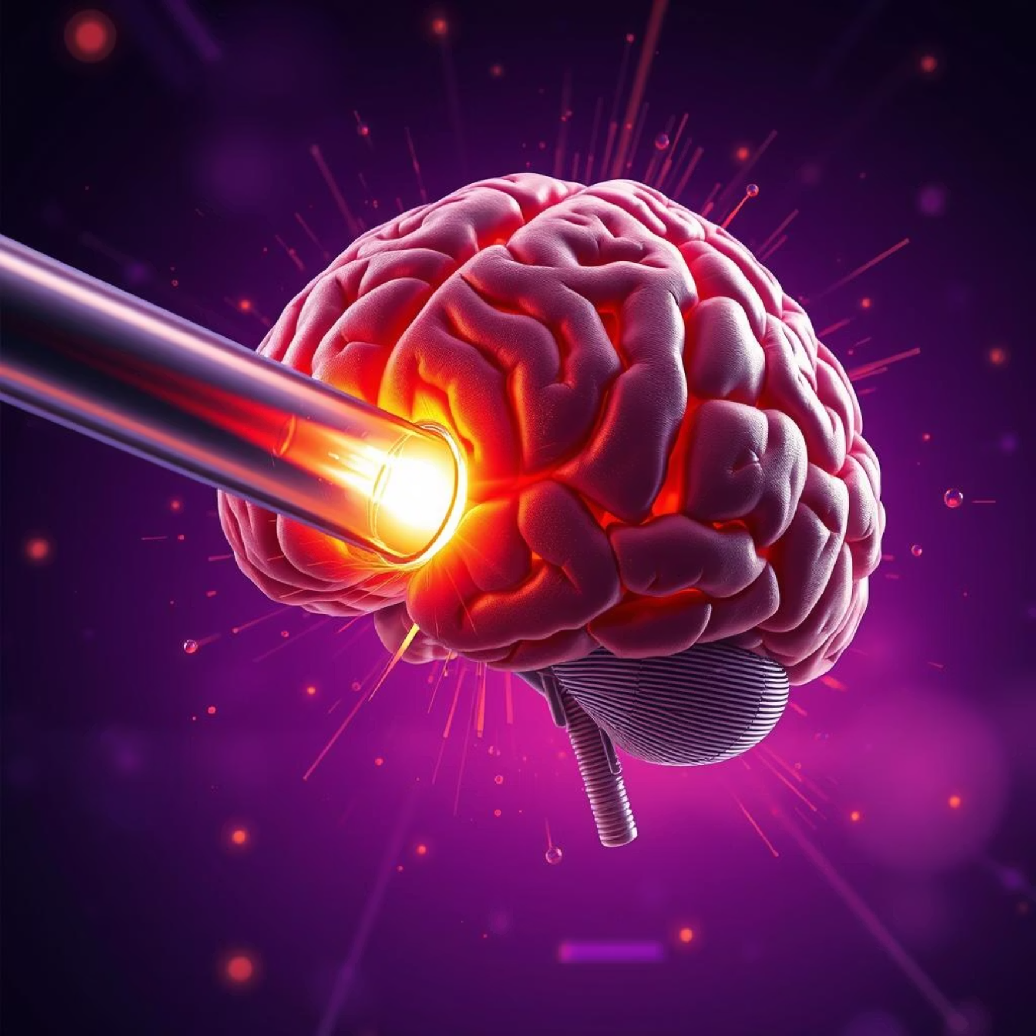

Primary vs. Secondary Brain Injury
Primary Injury
Secondary Injury
Occurs at the moment of impact and is irreversible.
Develops after the initial trauma and is often preventable with good care.
Hypoxia (lack of oxygen)
Hypotension (low blood pressure)
Brain swelling

Slide 6





Goals of Pre-Hospital TBI Management
Maintain Airway
Ensure clear breathing passages.
Ensure Oxygenation
Provide adequate oxygen supply.
Prevent Hypotension
Maintain stable blood pressure.
Maintain Cerebral Perfusion
Ensure sufficient blood flow to the brain.
Rapid Transport
Expedite transfer to a trauma center.

Slide 7

Airway & Oxygenation in TBI
Protect Airway
Use jaw thrust; avoid head tilt if cervical injury is suspected.
Maintain SpO₂
Keep oxygen saturation above 90%.
Suction Secretions
Clear any obstructions.
Oxygen Therapy
Administer as needed to maintain saturation.

Slide 8


Blood Pressure & Neuro Assessment
1
Avoid Hypotension
Maintain adult SBP ≥ 110 mmHg to ensure brain perfusion.
2
Monitor GCS
Regularly assess Glasgow Coma Scale for neurological status.
3
Pupil Check
Observe pupil size and reaction for signs of brain injury.
4
Frequent Reassessment
Continuously monitor patient during transport to the hospital.

Slide 9
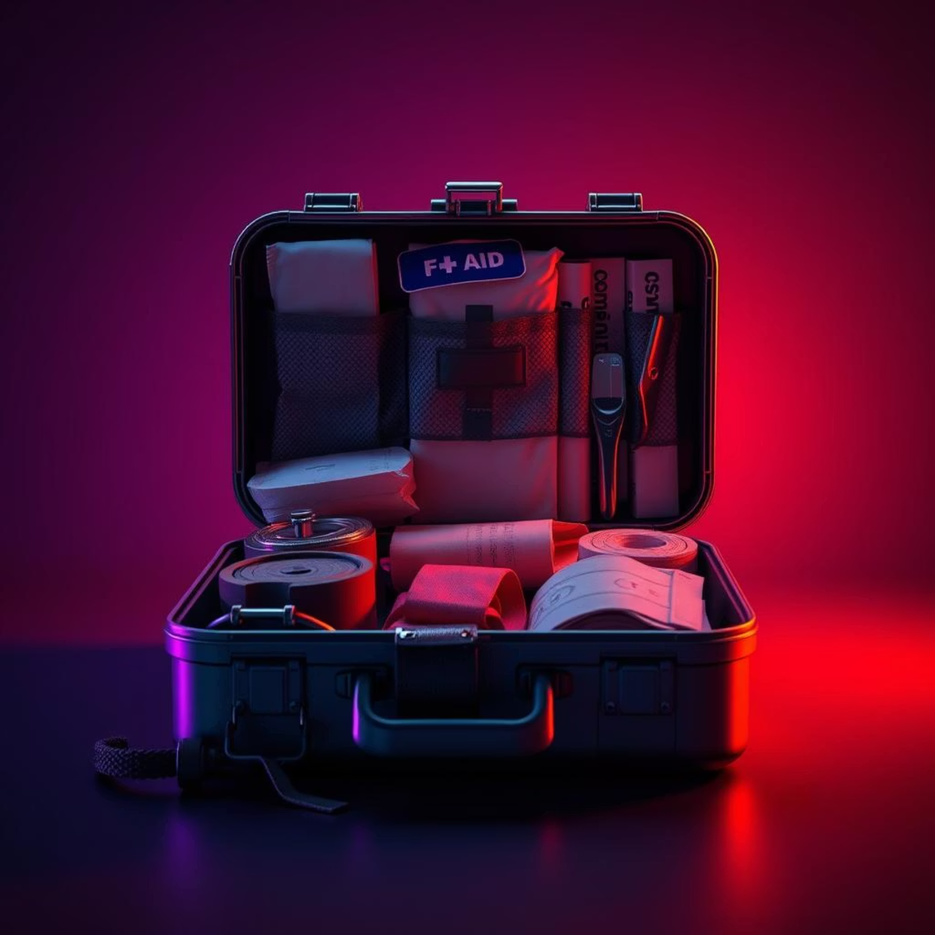

Summary: Critical Trauma Care
Hemorrhage Control
TBI Management
Direct pressure is the first step.
Prevent hypoxia and hypotension.
Tourniquets are life-saving tools.
Early care significantly improves outcomes.
Pre-hospital care is absolutely critical for trauma survival, making a profound difference in patient outcomes.

Slide 10

Thank You
Any Questions?

